Slide 1
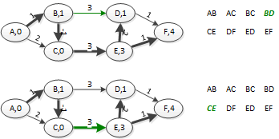

Bellman Ford, Iteration 2-5

Slide 2
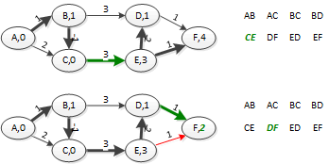
Bellman Ford, Iteration 2-6

Slide 3
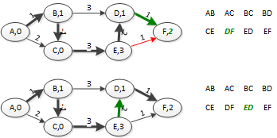
Bellman Ford, Iteration 2-7

Slide 4
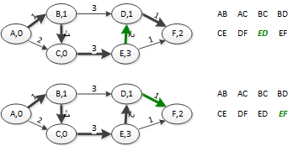
Bellman Ford, Iteration 2-8

Slide 5
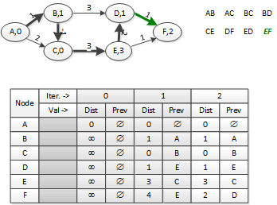
Bellman Ford, Iteration 2 end

Slide 6
Another View of Bellman-Ford (I)
After the first iteration, you’ve examined every edge once, so if any shortest path from s→v has only one edge, the algorithm has found it.
It may find some shortest paths with more than one edge.
But you can’t count on it.

Slide 7
Another View of Bellman-Ford (II)
After the second iteration, you’ve examined every edge twice, so if any shortest path from s→v has at most two edges, the algorithm has found it.
May find some shortest paths with more than two edges
But you can’t count on it.
After the third iteration, you’ve examined every edge thrice, so if any shortest path from s→v has at most three edges, the algorithm has found it.
May find some shortest paths with more than three edges
But you can’t count on it.

Slide 8
Another View of Bellman-Ford (III)
…
After the (|V|-1)^{st} iteration, you’ve examined every edge |V|-1 times, so if any shortest path from s→v has at most |V|-1 edges, the algorithm has found it.
Since a shortest path has no cycles, this is the longest possible length of a shortest path
The algorithm has found the shortest path graph.

Slide 9
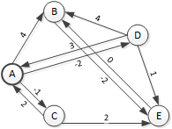
Another View of Bellman-Ford (IV)
Run the algorithm one more iteration. If the algorithm reduces the distance from s to any node, there is a negative-weight cycle in the graph. (B ← → E)

Slide 10
Bellman-Ford Running Time
You check each edge in E once per iteration.
There are V iterations.
Relaxing an edge is a constant time operation.
So the running time of Bellman-Ford is O(V) [initialization] + O(VE) = O(VE)

Slide 11
DAG Shortest Path
If you have a directed acyclic graph, there is an easier way to find the shortest path tree in this graph.
Useful for finding the critical path through a set of activities.
Finding the critical path through the activity assumes you have the resources to do things in parallel.

Slide 12
DAG Shortest Path algorithm
Dag-Shortest-Path (G, w, s)
Topologically sort the vertices of G O(V+E) (DFS)
Initialize single source O(V)
For each vertex u, in topological order O(V+E)♦
For each vertex v adjacent to u
Relax(u,v,w)
♦:The outer for loop is executed once per vertex, but the only work it does is relaxing edges. Each edge gets relaxed once. So the outer for loop is O(V+E)
O(V+E) total

Slide 13
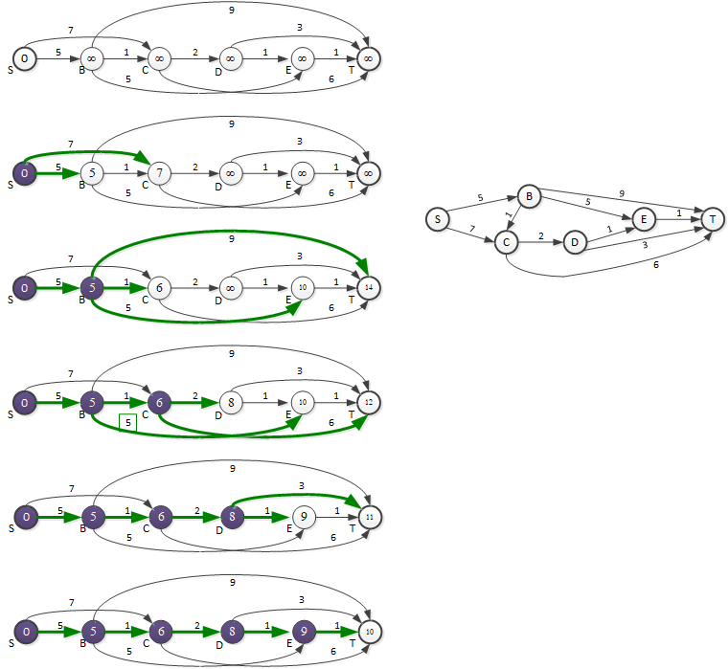
DAG- Quiz Example

Slide 14
Lowest-Cost-First Search (Dijkstra’s Algorithm)
Breadth first search, with edge weights.
Only works if all edge weights non-negative.
Instead of going to the nearest unfinished (gray, red) node by number of edges, go to the nearest unfinished node by total edge length from the start node.
First, find the node nearest the start.
Shortest path to this node is the direct path
In general, find the node nearest any “black” (processed) node
Shortest path to this node uses subpaths already known to be shortest
Continue until done

Slide 15
LCFS/Dijkstra II
Generally called Lowest-Cost-First search if you are searching for a specific node and plan to stop when you find it.
Generally called Dijkstra’s Algorithm when you plan to search entire graph.
Just breadth first search, with edge weights.
Instead of going to the nearest unfinished (gray, red) node by number of edges, go to the nearest unfinished node by total edge length from the start node.

Slide 16
LCFS/Dijkstra III
This means the distances to the discovered-but-unfinished nodes can change partway through the algorithm.
All that matters is the nearest unfinished node to the start.
This suggests using a heap to keep the information.

Slide 17
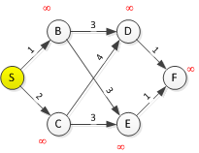
LCFS/Dijkstra Example
Node | D(S) | Prev | Root | D(S) | Prev | Node | D(S) | Prev | Node | D(S) | Prev
1st |  |  | S | 0
S | 0 |  | B | 1 | S | C | 2 | S

Slide 18
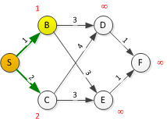
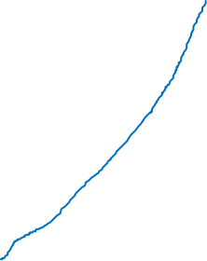
Node | D(S) | Prev | Root | D(S) | Prev | Node | D(S) | Prev | Node | D(S) | Prev
1st |  |  | S | 0
S | 0 |  | B | 1 | S | C | 2 | S
B | 1 | S | C | 2 | S | D | 4 | B | E | 4 | B

Slide 19
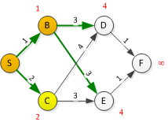
Node | D(S) | Prev | Root | D(S) | Prev | Node | D(S) | Prev | Node | D(S) | Prev
1st |  |  | S | 0
S | 0 |  | B | 1 | S | C | 2 | S
B | 1 | S | C | 2 | S | D | 4 | B | E | 4 | B
C | 2 | S | D | 4 | B | E | 4 | B

Slide 20
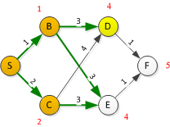
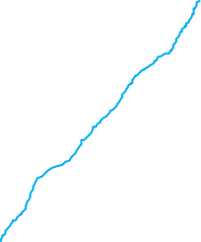
Node | D(S) | Prev | Root | D(S) | Prev | Node | D(S) | Prev | Node | D(S) | Prev
1st |  |  | S | 0
S | 0 |  | B | 1 | S | C | 2 | S
B | 1 | S | C | 2 | S | D | 4 | B | E | 4 | B
C | 2 | S | D | 4 | B | E | 4 | B
D | 4 | B | E | 4 | B | F | 5 | D

Slide 21
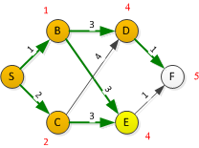

Node | D(S) | Prev | Root | D(S) | Prev | Node | D(S) | Prev | Node | D(S) | Prev
1st |  |  | S | 0
S | 0 |  | B | 1 | S | C | 2 | S
B | 1 | S | C | 2 | S | D | 4 | B | E | 4 | B
C | 2 | S | D | 4 | B | E | 4 | B
D | 4 | B | E | 4 | B | F | 5 | D
E | 4 | B | F | 5 | D

Slide 22
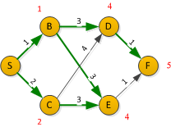
Node | D(S) | Prev | Root | D(S) | Prev | Node | D(S) | Prev | Node | D(S) | Prev
1st |  |  | S | 0
S | 0 |  | B | 1 | S | C | 2 | S
B | 1 | S | C | 2 | S | D | 4 | B | E | 4 | B
C | 2 | S | D | 4 | B | E | 4 | B
D | 4 | B | E | 4 | B | F | 5 | D
E | 4 | B | F | 5 | D
F | 5 | D

Slide 23
Pseudocode: full search [Djikstra]
LCFS/Dijkstra (G,w,s)
Initialize-single-source( G, s )
S = ∅
Q = G.V
While Q != ∅
u = Extract-Min(Q)
S = S ∪ {u}
Record distance to u and predecessor
for each node v ∈ G.Adj[u]
Relax(u,v,w)

Slide 24
Pseudocode: Goal Search
LCFS/Dijkstra (G,w,s,goal)
Initialize-single-source( G, s )
S = ∅
Q = G.V
While Q != ∅
u = Extract-Min(Q)
S = S ∪ {u}
if (u = goal)
halt
for each node v ∈ G.Adj[u]
Relax(u,v,w)

Slide 25
LCFS/Dijkstra’s Algorithm, Running Time
Depends on implementation of the priority queue
Array implementation: O(V²+E) = O(V²)
Insert is O(1), called O(V) times
Relax edge is O(1), called O(E) times
Extract-Min is O(V), called O(V) times
Keep priority queue sorted, O(V lg V)
BUT possible if you change one element to re-sort in O(V)
So with initial sort O(V lg V)
O(V) + O(E) + O(V lg V) + O(V²) = O(V²)

Slide 26
LCFS/Dijkstra’s Algorithm, Running Time
Binary Heap implementation: O(E lg V)
Insert is O(V), called once
Decrease-Key is O(lg V), called O(E) times (relax edge)
Extract-Min is O(lg V), called O(V) times
O(V) + O(E lf V) + O(V lg V) = O(E lg V)
Since E > V, usually
Java’s Priority Queue class uses a heap.

